Slide 1
Autoencoders and GANs
Varol Kayhan, PhD

Slide 2
Autoencoders
Can learn “data representation”
“latent representation”
“coding”
Unsupervised learning technique
Used for dimension reduction
Some of them can also generate new data

Slide 3
“Data Representation”???
Data representation ≈ patterns
Can you identify any “patterns”?
Bedrooms | Baths | Garage (cars)
3 | 3 | 3
2 | 2 | 2
3 | 1 | 1
2 | 1 | 1
4 | 4 | 4
4 | 1 | 1
Each row represents one house

Slide 4
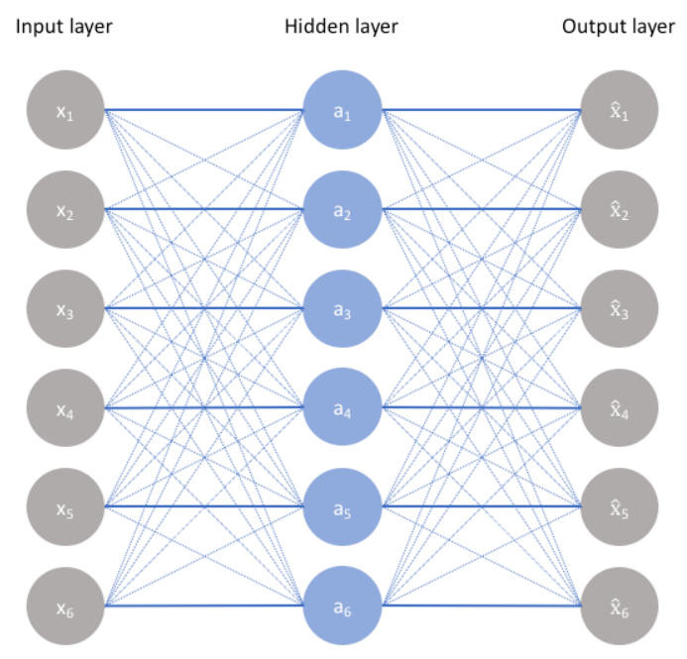
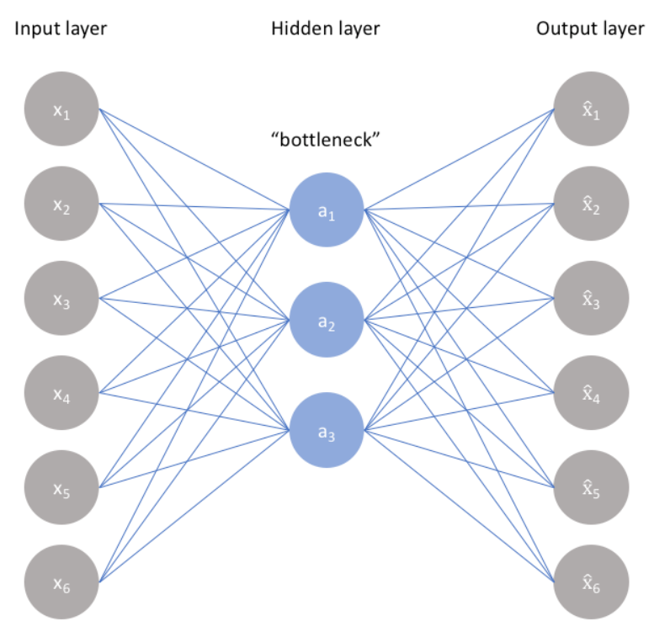
How do Autoencoders work?
Learns how to “regenerate” the inputs (i.e., columns/features) using a neural network
Prevent “cheating” by creating a bottleneck in the network
Minimize the “regeneration error” at the output layer
Enables “cheating”

Slide 5
Why use Autoencoders?
Anomaly (outlier) detection!
Usually, 99% data is “normal”
Not suitable for supervised learning
Train the autoencoder on 99% of data
Learns the “normal” data representation
Data “regeneration error” is small
Send the anomalous data
Doesn’t know how to regenerate the data
Regeneration error is LARGE!

Slide 6
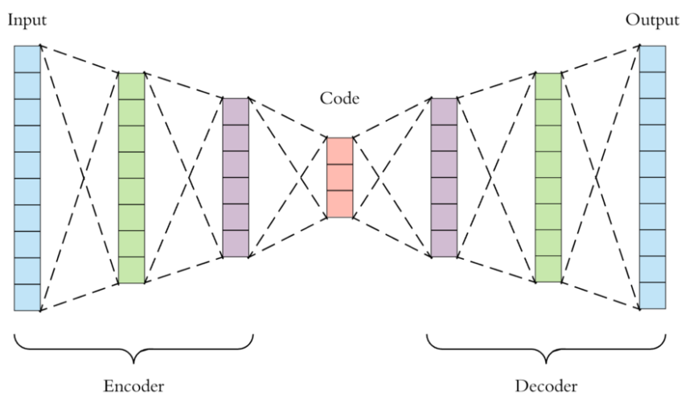
Autoencoders
Consists of two parts
N inputs
N outputs
Latent representation

Slide 7
Autoencoders
Performs principal component analysis (PCA) IF:
Uses linear activation functions
Cost function is Mean Squared Error
Principal components

Slide 8
Stacked (Deep) Autoencoders
More than one hidden layer
Be careful:
Don’t make it too powerful
It will learn to create each input individually
(Overfitting)
Input layer
Output layer

Slide 9
Stacked (Deep) Autoencoders
How to configure the layers?
If input variables are binary:
Inner layers: use non-linear activation functions (selu, relu)
Output layer: use sigmoid activation function
Coverts the outputs to values between 0 and 1
Output layer: use binary_crossentropy as the loss function (treat it as classification)
If input variables are continuous:
Inner layers: use non-linear activation functions (selu, relu)
Output layer: do NOT use an activation function (it will use a linear function)
Output layer: use mean_squared_error as the loss function (treat it as regression)

Slide 10
Autoencoders: Unsupervised Pretraining
Another use for autoencoders (useful for images)
What if you have very few labeled data (for supervised learning)?
Bedrooms | Baths | Garage (cars)
3 | 3 | 3
2 | 2 | 2
3 | 1 | 1
2 | 1 | 1
4 | 4 | 4
4 | 1 | 1
unlabeled
“Single-family”
unlabeled
“Condo”
unlabeled
unlabeled

Slide 11
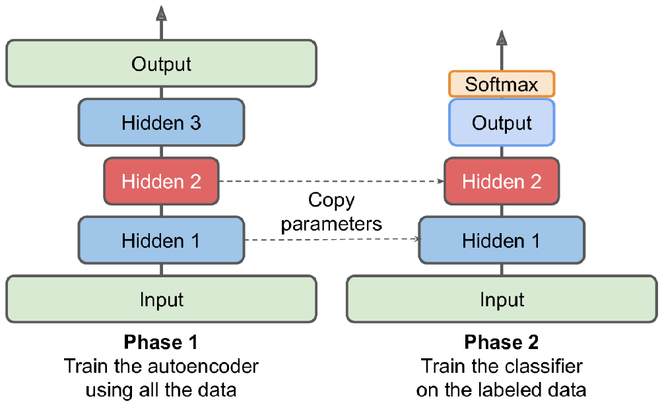
Autoencoders: Unsupervised Pretraining
Learn the pattern using the autoencoder
Copy the layers and FREEZE them
Train the output layer on the few labeled data
Perform predictions!

Slide 12
Convolutional Autoencoders
Use of autoencoders for images
Encoder:
Reduce image size (height, width) using with conv. and pooling layers
Increase depth using feature maps
Decoder:
Upscale image size (back to same height, width)
Decrease depth

Slide 13
Recurrent Autoencoders
Learns the data representation in time-series data
Use RepeatVector in bottleneck
Settings and configuration are similar

Slide 14
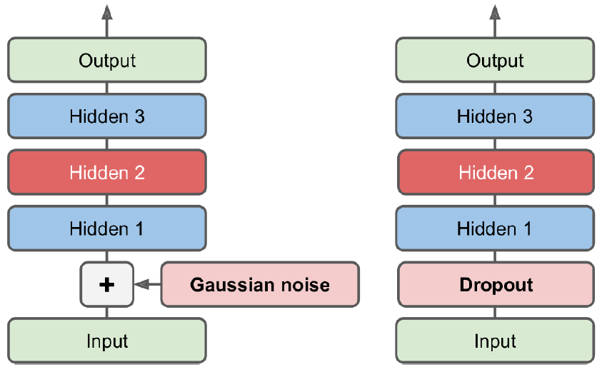
Other kinds of Autoencoders
Don’t have to create bottleneck all the time
Use other tricks to prevent “cheating”

Slide 15
Generative Adversarial Networks (GANs)
Unsupervised technique
Used to generate new data
http://www.thispersondoesnotexist.com
http://www.thisrentaldoesnotexist.com
Possible uses:
Increase image resolution
Image colorization
Replace image background
Turn sketch into realistic image
Generate text, audio, time series
Etc.

Slide 16
How do GANs work?
Consists of two neural networks
Generator: generates fake data that looks like training data
Discriminator: distinguishes between real and fake data
Two networks compete against each other:
Generator: creates fake money
Discriminator: bank that catches fake money (but also tells generator how to create better fake money)
Training GANs are difficult
Networks reach a Nash equilibrium

Slide 17
Training GANs
Step 1: Train the discriminator
Let the generator create fake (random) data (and label as 0)
Sample from real data (and label as 1)
Train the discriminator on the labeled data
Step 2: Train the generator
Freeze the discriminator
Let the generator create another batch of fake data (AND LABEL AS 1)
Send the fake data to discriminator (to score/predict)
Because of the label, discriminator generates error
Use the errors for backpropagation and train the GENERATOR
REPEAT both steps for a second batch, third batch, etc.
(Generator NEVER sees real data. But, it learns how to create real data from the discriminator)

Slide 18
Difficulties of Training
Generator and discriminator try to outsmart each other
Parameters may end up oscillating, becoming unstable
They may reach a Nash equilibrium (zero-sum game)
Nobody changes their strategy UNLESS the other also changes strategy
Also, mode collapse can occur (in multi-class tasks)
Generator learns only one category really well, forgets others
Discriminator can’t identify fake from real
So, generator moves on to another category, and forgets the previous one

Slide 19
GANs
Most GANs are used for generating images
Deep Convolutional GANs (DCGANS)
Progressively growing GANS
StyleGANs
There are recommendations to prevent training problems

Slide 20
Summary
Autoencoders
Unsupervised
Learns data representation
GANs
Two networks go against each other
Generates new (fake) “data”

